Slide 1

ESCUDDO: Micro-Costing and Cost-Effectiveness Study
Jane J. Kim, PhD
Nicole G. Campos, PhD
Stephen Resch, PhD

Slide 2
Objectives
To estimate the total financial and economic costs of HPV vaccination with one versus two doses, as well as cervical cancer screening, in Costa Rica’s public health care system.
Financial costs: actual expenditures on goods and services
Economic costs: opportunity cost of all resources used
To project the long-term health and economic impact and value (i.e., cost-effectiveness) of one versus two doses in the context of Costa Rica’s cervical cancer prevention program.

Slide 3
Objectives
To estimate the total financial and economic costs of HPV vaccination with one versus two doses, as well as cervical cancer screening, in Costa Rica’s public health care system.
Financial costs: actual expenditures on goods and services
Economic costs: opportunity cost of all resources used
To project the long-term health and economic impact and value (i.e., cost-effectiveness) of one versus two doses in the context of Costa Rica’s cervical cancer prevention program.

Slide 4

Methods: Micro-Costing
To measure and aggregate all resource ‘ingredients’ used to provide a service at the patient level.
Direct medical costs: Medical resources directly needed for the intervention (e.g., tests, drugs, supplies, personnel)
Direct non-medical costs: Resources consumed as part of intervention (e.g., patient transportation to/from clinic)
Patient time costs: Time spent traveling and waiting for or receiving care.

Slide 5
Methods: Data Sources
Key informant interviews
Regional, district level health officers
Program managers
Clinic administrators
Providers
Laboratory staff
Budget spreadsheets
Invoices
Direct observation/time in motion studies

Slide 6
Major Cost Components: New HPV Vaccination Program
Capital costs
Introduction costs
Micro planning
Training
Initial social mobilization
Initial information, education, communication (IEC) material
Additional cold chain equipment
Other equipment (vehicles, incinerators)
Recurrent costs
Vaccines and injection materials
Service delivery (school-based; Caja-based) *mostly labor
Supervision and monitoring
Waste management
Cold chain maintenance
Continuing social mobilization
Continuing IEC material

Slide 7
Outcomes from Cost Analysis: HPV Vaccination
Under varying assumptions surrounding roll-out, the microcosting study will estimate the following:
Cost per dose:
Total costs of HPV vaccination program
Total number of HPV vaccine doses administered
Cost per fully immunized girl (FIG):
Total cost of HPV vaccination program
Total number of fully immunized girls (FIG)

Slide 8
Major Cost Components: Cervical Screening
Direct medical costs | Direct non-medical costs | Patient time costs | Cost of illness
Clinical/laboratory supplies | Programmatic costs | Patient time | Cancer staging and treatment
Clinical/laboratory equipment | Training | Transportation | Follow-up care
Clinical/laboratory personnel time | Social mobilization and outreach | Waiting for and receiving care | Patient and support person meals/housing
 | Information, education, and communication (IEC) material
 | Information systems
 | New equipment
 | Patient transportation

Slide 9
Outcomes from Cost Analysis: Cervical Screening
The micro-costing study will estimate the following, which will be applied within the microsimulation model of HPV-induced cervical carcinogenesis to estimate the cost per woman screened:
Cost per procedure:
Screening test
Colposcopy/diagnostic testing
Treatment
Cancer staging and treatment
Cost per woman screened:
Total cost of screening, diagnosis, and treatment
Total number of women

Slide 10
Applications for Costing Data
Budget impact analysis: Microcosting data can be used to project the financial costs of HPV vaccination to inform decision-makers (e.g., Ministry of Health).
Cost-effectiveness analysis: Microcosting data can be used for formal assessment of the value for money (i.e., dollars per year of life saved) associated with HPV vaccination in the context of Costa Rica’s cervical cancer prevention program.

Slide 11
Objectives
To estimate the total financial and economic costs of clinic-based adolescent HPV vaccination with one versus two doses.
Financial costs: actual expenditures on goods and services
Economic costs: opportunity cost of all resources used
To project the long-term health and economic impact and value (i.e., cost-effectiveness) of one versus two doses in the context of Costa Rica’s cervical cancer prevention program.

Slide 12
General Analytic Framework
1. Develop a model
To capture key elements of disease process in population of interest
To synthesize existing evidence and data
To reflect knowledge and uncertainty about model inputs and assumptions
To ensure projected outcomes consistent with empirical data
a. Parameterization
b. Calibration
c. Validation
2. Simulate strategies
To project short- and long-term population health and cost outcomes
3. Explore uncertainties
To explore the influence of critical uncertainties, alternative scenarios on results

Slide 13
Methods: Mathematical Simulation Models
HPV transmission model
Agent-based model (individual partnership)
Stratified by 9-valent HPV types
Incorporates sexual behavior data
Captures herd immunity
Cervical cancer natural history model
Microsimulation model (individual women)
Stratified by 9-valent HPV, other HR HPV, LR HPV
Tracks disease progression, clinical events, expenditures over woman’s lifetime

Slide 14
Model Schematic
Precancer
CIN2
HPV infection
(HPV-16, -18, -31, -33, -45, -52, -58, other high-risk, low risk)
Cancer
(local, regional, distant)
No HPV infection
CIN3
Transitions can vary by:
Age
HPV type
Duration of infection/precancer
History of prior HPV infection
* Campos et al (Am J Epidemiol 2014)

Slide 15






Input Parameters
Demographic
Sexual Mixing and HPV Transmission*
Natural History
Intervention
(screening and vaccination)
Economic
Analytic
* Dynamic model of HPV transmission

Slide 16
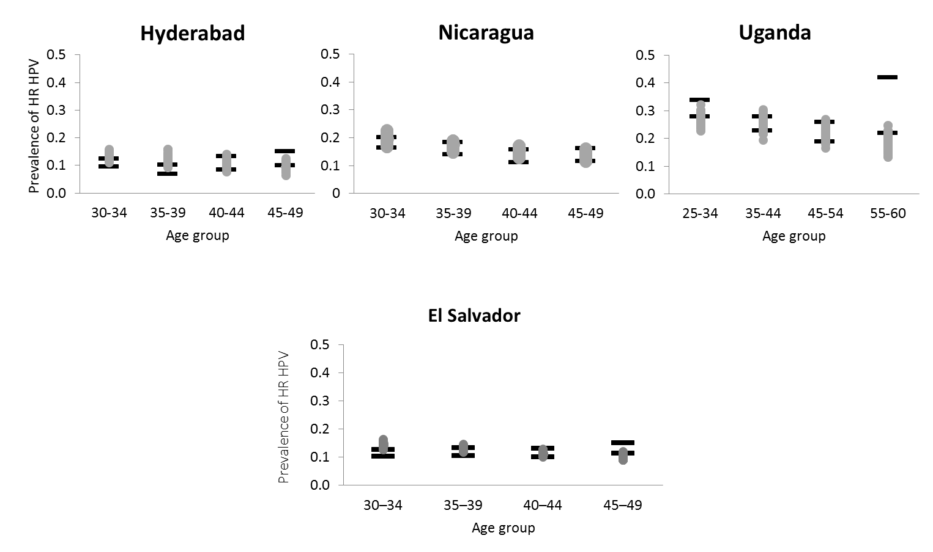
Calibration Examples
HPV Prevalence (LMIC)

Slide 17
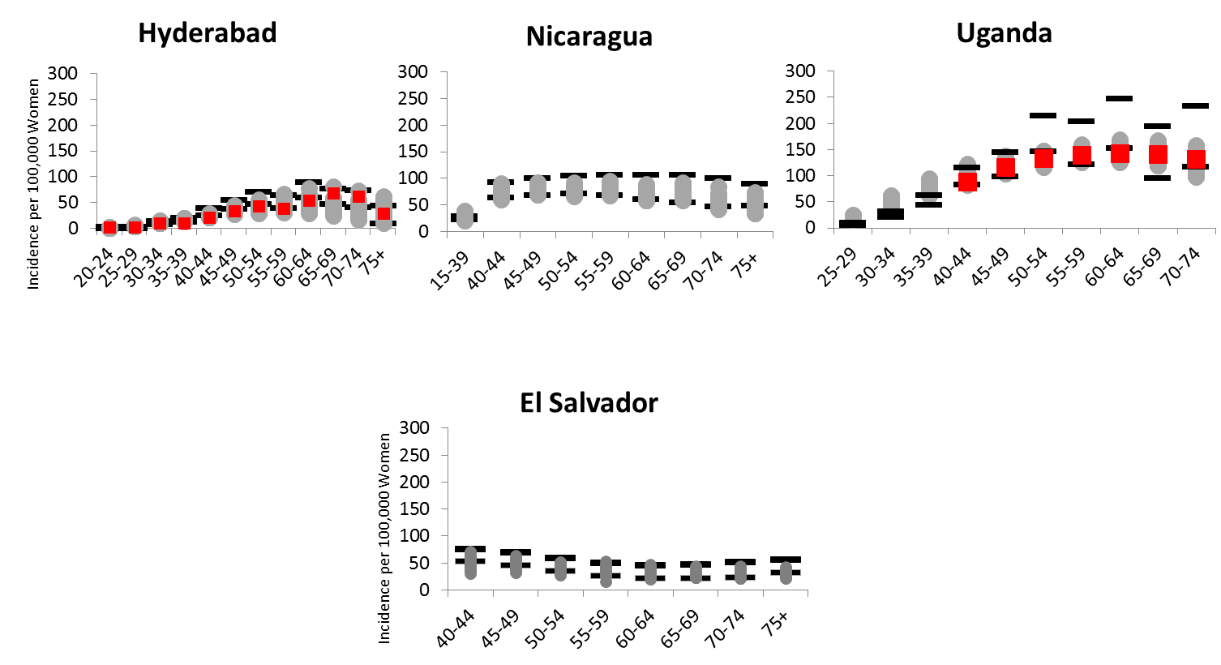
Calibration Examples
CC Incidence (LMIC)

Slide 18
Strategies
No intervention
HPV vaccination (female adolescent)
1 dose
2 doses
Screening alone
Combined HPV vaccination (adolescence) and screening (adulthood)

Slide 19
Model Outcomes
Reductions in lifetime cervical cancer risk, mortality
Life expectancy gains
Lifetime costs
Incremental cost-effectiveness ratios (cost per YLS):
Net increase in cost
Net gain in health effect
1x GDP per capita for very cost-effective interventions: $12,240 (2019 USD)

Slide 20
Sensitivity Analyses (one versus two HPV vaccine doses)
Vaccine uptake (by time, age, sex), completion
Vaccine efficacy, duration, waning function
Screening coverage (age, frequency, test), follow-up
Cancer survival
Costs

Slide 21
Next Steps…
Establish procedures for documenting costs.
Ethics Review Board/IRB processes
Identify individuals who are familiar with processes of care within the health care system.
Outline processes for vaccine delivery and screening related procedures.
Compile costing data collection tools and key informant questionnaires.
Identify individuals to assist with cost data collection.
Determine sites for cost data collection.
Determine timeline for cost data collection.

